Slide 1


Experience API

Slide 2


Slide 3

0900 – 1000 Welcome and Overview
1000 – 1015 Q&A and Discussion
1015 – 1030 Break
1030 – 1200 Intro to the xAPI Technology (+ hands on)
1200 – 1315 Lunch
1315 – 1335 Understanding xAPI Profiles
1335 – 1355 Using xAPI Launch
1355 – 1500 Creating xAPI Web-Based Content (+ hands on)
1500 – 1515 Break
1515 – 1615 xAPI Content in SCORM Courses (+ hands on)
1615 – 1700 xAPI Dashboard to Build Graphs and Charts (+ hands on)

Slide 4
Experience API

Slide 5
Experience API
Track data of learning experiences, broadly defined
Enable machine-readable communication (interoperability), storage, and access of the data

Slide 6

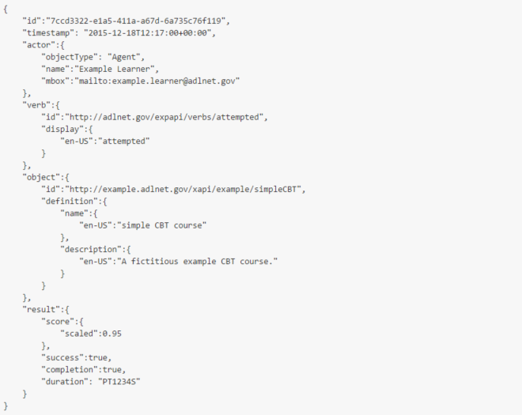
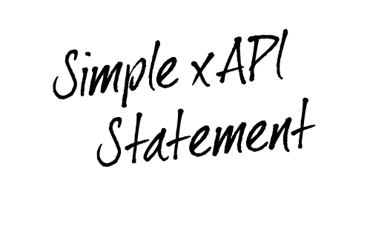

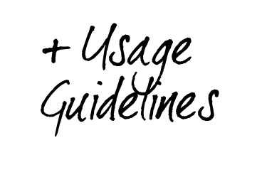
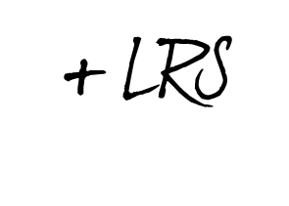

Notes:
xAPI is a specification for defining data, as well as set of reference implementation models for its uses (i.e., usage guidelines such as the different profiles) and nested specifications for its storage, authentication, and access (i.e., the LRS)
The Experience API (xAPI) is a technical specification for implementing a Restful architecture consisting of a Learning Record Store (LRS) and 4 specific web-service Application Program Interface (APIs). The xAPI is agnostic about the type of learning content being delivered, and allows flexible tracking of learning activities and experiences, including formal e-learning courses, performance-based tracking, group-based or social learning, and even informal learning scenarios.

Slide 7







Slide 8

Notes:
xAPI Brief Overview
ADL Prototype Learning Record Store (LRS)
ADL “How to make French Toast” Course Demonstration
Designing an xAPI Data Approach
Looking at xAPI Data after Storage
Creating Graphs, Dashboards and Visualizations

Slide 9

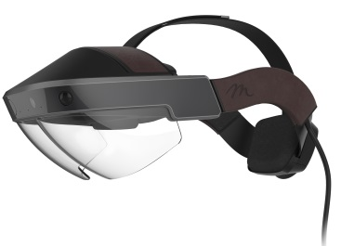
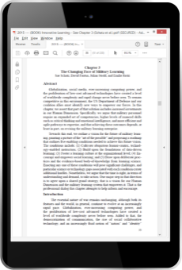

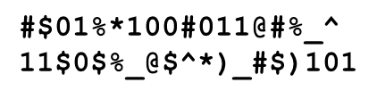
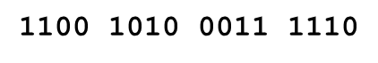
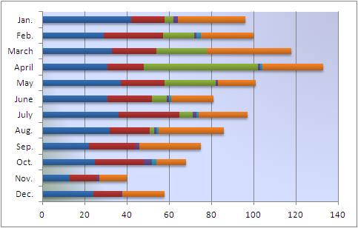
xAPI
Profile
Learning Mgmt System (LMS)
LRS²
API
Learning Record Provider
Learning Record Store (LRS)
LRS³
Learning Record Consumer
LRS⁴
xAPI Statement
the Environment
Notes:
Learning Record Store – Basically the xAPI database
Learning Record Provider – Provides data (it could be anything, i.e., a web-based course, a simulation, any input system)
Learning Record Consumer – Consumes data
Profile
Can you use multiple profiles? Yes, e.g., implementing SCORM, video, and personalized homemade profiles

Slide 10
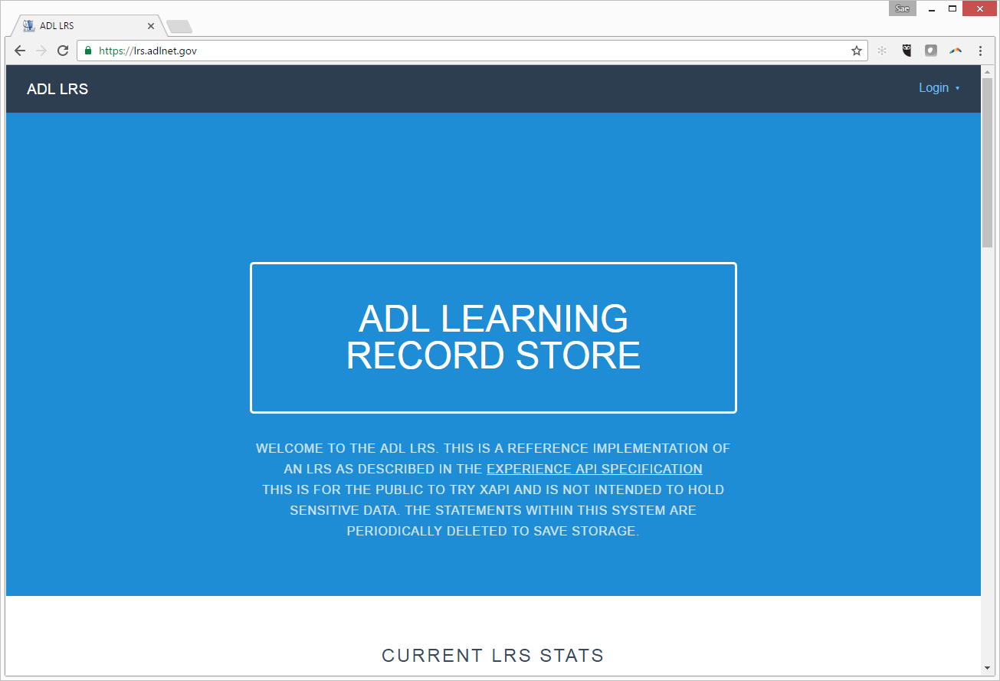
Hosted ADL LRS @ https://lrs.adlnet.gov

Slide 11
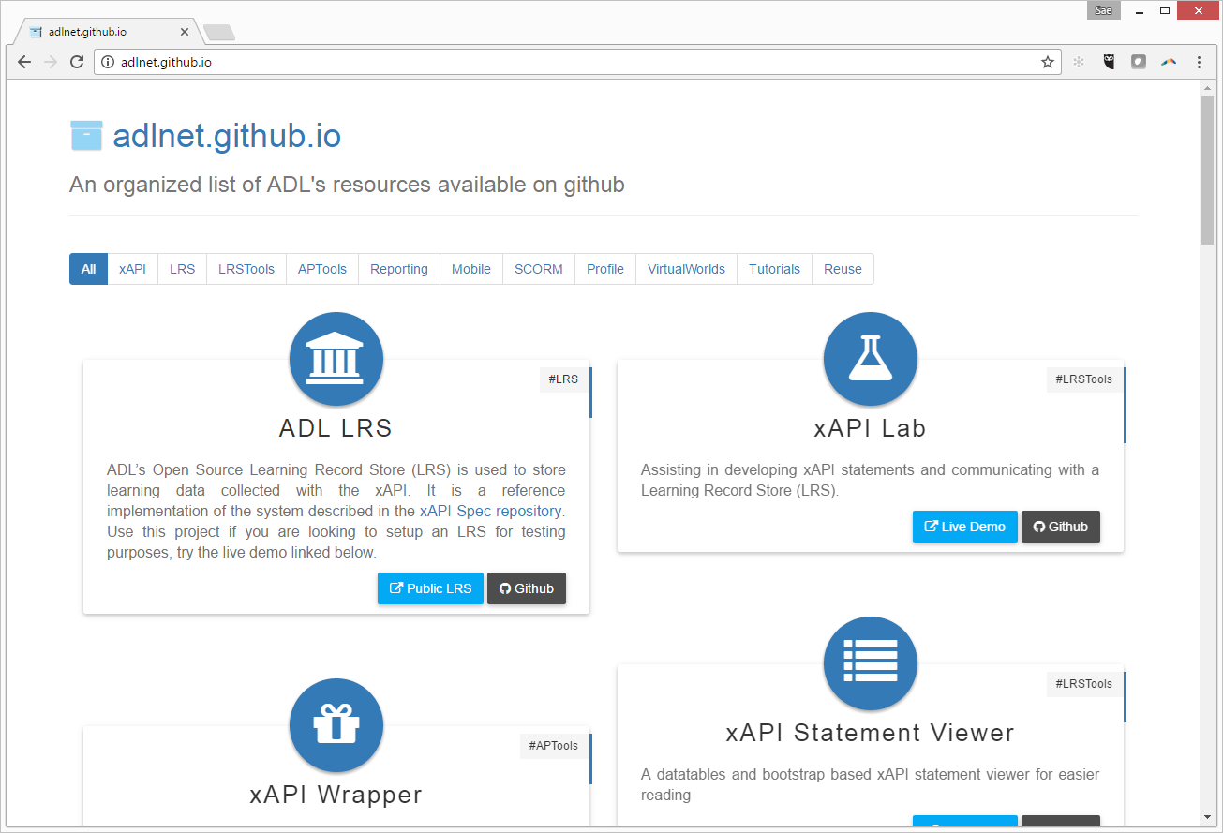
ADL Usage Guides (e.g., profiles, snippets) @ http://adlnet.github.io

Slide 12
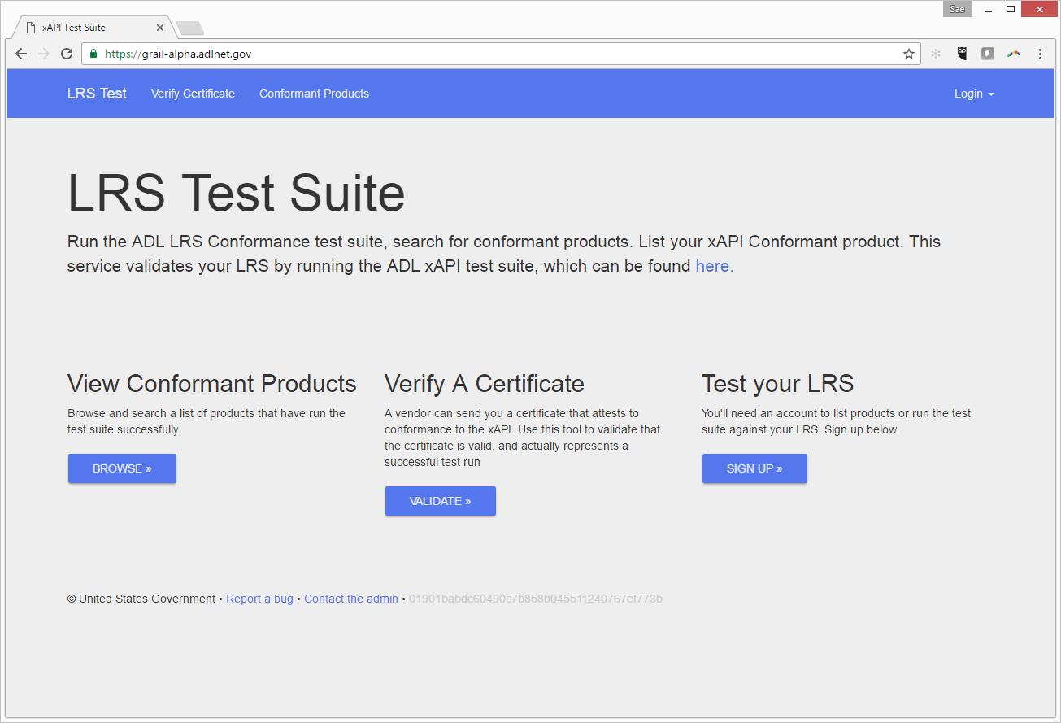

ADL xAPI Certification Test Suite (for LRS) @ https://grail-alpha.adlnet.gov/

Slide 14
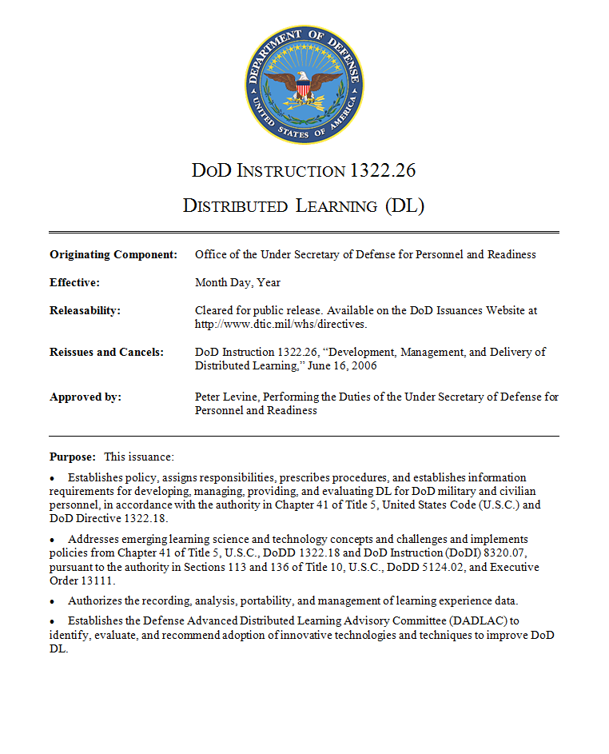
DoDI 1322.26

Slide 15

2016
DoDI 1322.26 (V2)
2006
DoDI 1322.26 (V1)
1322.26 Update
2012
Notes:
2006
DoDI 1322.26 (V1) published
Directs use of SCORM
2012
1322.26 Update
Abortive attempt to update DoDI
2016
DoDI 1322.26 (V2)
Revise and resubmit DoDI
Supports use of xAPI

Slide 16
2016
DoDI 1322.26 (V2)
Reaffirms ADL as authority on learning tech standards for DoD
Directs DoD to implement emerging interoperability specs, e.g., xAPI
Formally charters DADLAC as DoDI 1322.26 oversight body
Notes:
Reaffirms ADL as authority on learning tech standards for DoD
Directs DoD to implement emerging interoperability specs, e.g., xAPI
Formally charters DADLAC as DoDI 1322.26 oversight body
#2 is important and relevant for today… but how to keep it updated?

Slide 17
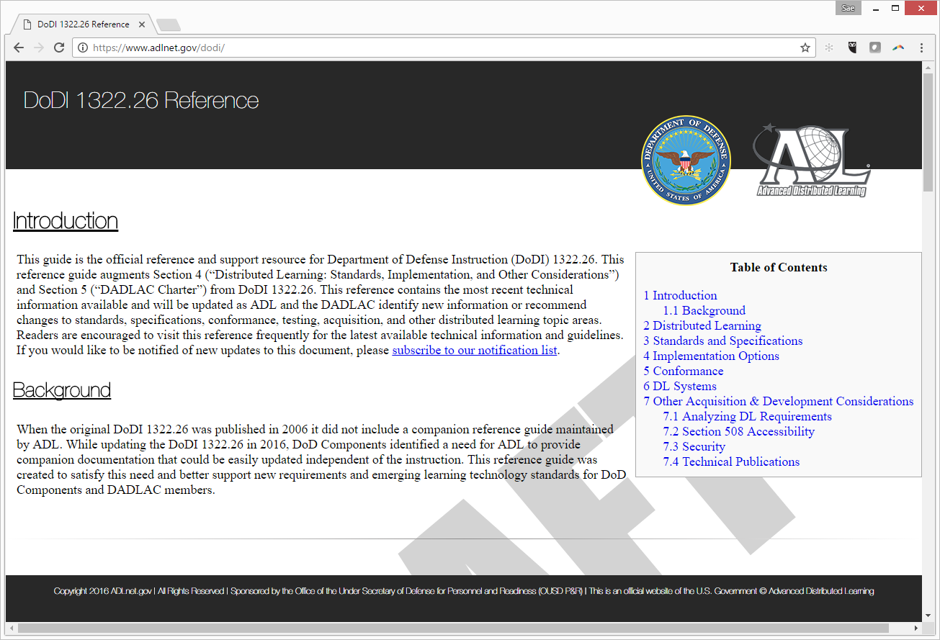
Fungible References @ https://adlnet.gov/dodi
Notes:
Supporting “fungible” references for the DoDI are available at http://adlnet.gov/dodi
xAPI LRS Conformance Requirements Published (October 2016)
http://TBD
Will begin reviewing legacy SCORM documents for necessary revisions and update where possible (October/November 2016)
ADL stood up initial xAPI LRS Test Suite development team (June 2016)

Slide 18
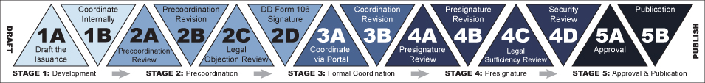
Current Status
DODI APPROVAL PROCESS
Next big step:
Formal Coordination
Notes:
DoDI 1322.26 Update
Currently at Stage 2C (Legal Objection Review)
ADL has revised the issuance and the DD Form 106 as directed by WHS compliance analysts.
Next big step is Stage 3B (Coordination Revision)

Slide 20

Future
of (Learning) Interoperability
Notes:
A brief glimpse
Total Learning Architecture
The Total Learning Architecture is a collection of specifications for accessing and making use of learning-related data.

Slide 21
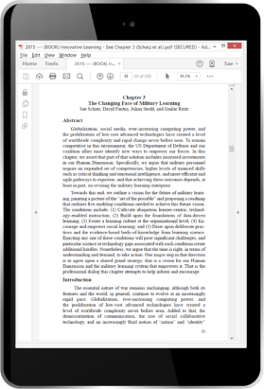




e-book
LMS
Mobile
VR Simulation

Slide 22
e-book
LMS
Mobile
VR Simulation

Slide 23




Slide 24


Slide 25
xAPI
Meta-Adaptation
Content
Learner
Pedagogy
Context
Competencies

Slide 26
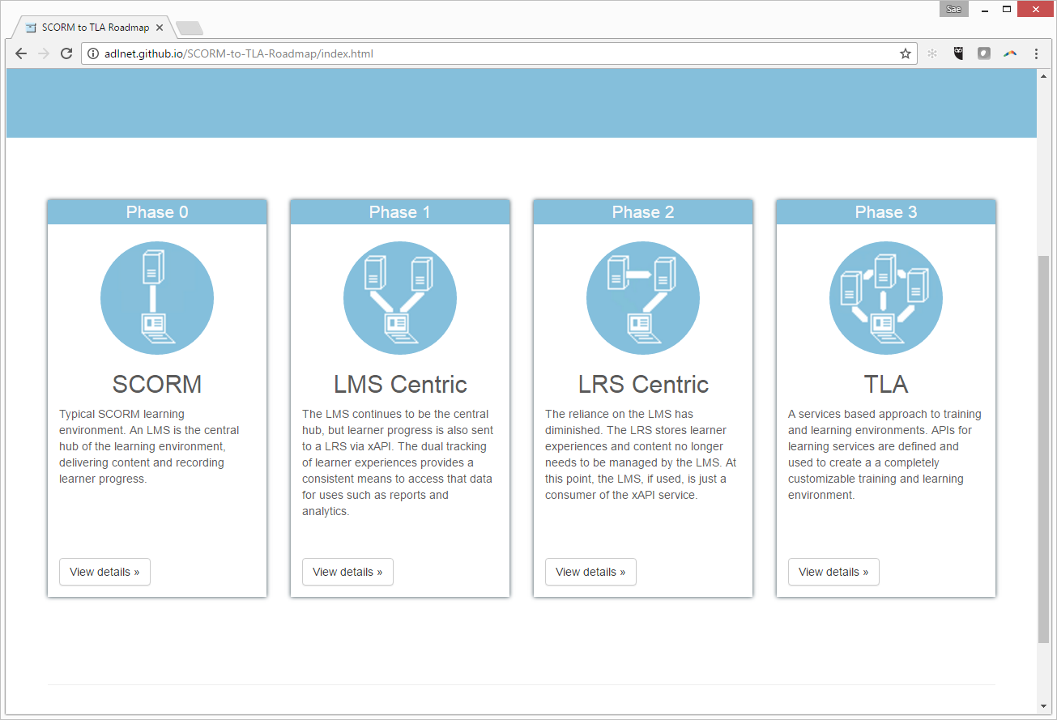
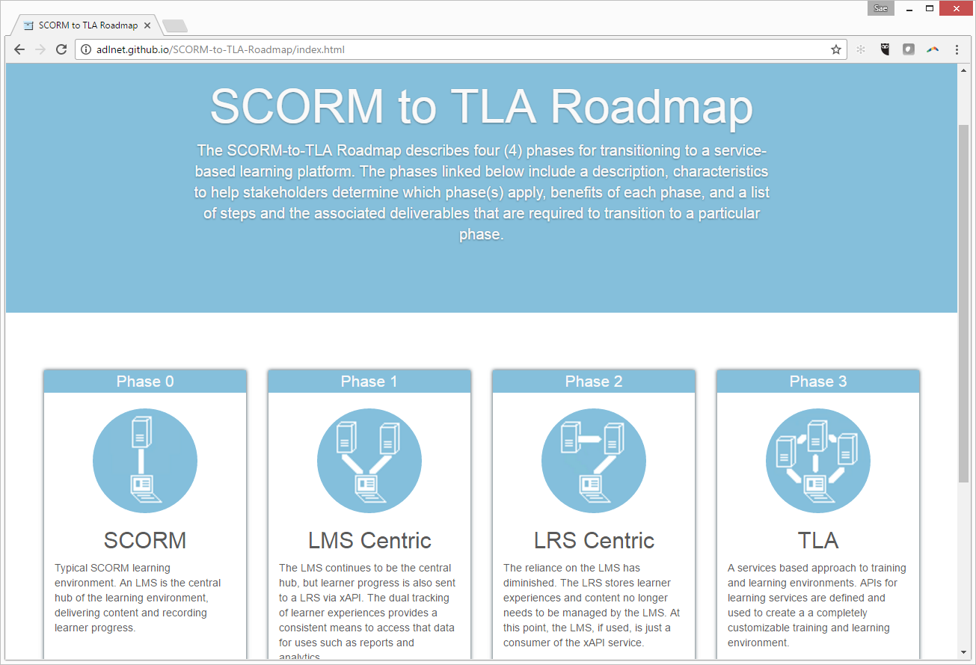

Fungible References @ http://adlnet.github.io/SCORM-to-TLA-Roadmap

Slide 27



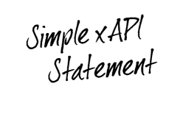

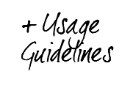
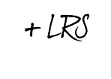


xAPI Overview
DoDI 1322.26
Future Vision

